Slide 1

DEPARTMENT OF COMPUTER SCIENCE AND ENGINEERING
CRYPTOCURRENCY TRADING PLATFORM
Under the Guidance of
Dr. K.VINOD KUMAR
Asst. Professor, M.Tech, Ph.D
B.SHANTHI(R190664)
P.UDAYA SILPA(R190077)

Slide 2
Abstract
The Cryptocurrency Trading Platform is a comprehensive solution for secure and real-time cryptocurrency trading.
Developed using Spring Boot (backend) and React.js (frontend) to ensure seamless performance and scalability.
Integrates CoinGecko APIs to provide accurate market data, price fluctuations, and trading volume.
Implements Two-Factor Authentication (2FA) and OTP-based login for enhanced security.
Features a real-time data dashboard for top 50 cryptocurrencies with dynamic visualizations.
Supports secure wallet management, transaction history logging, and interactive trading.
Includes an AI-powered chatbot for user support, answering crypto-related queries instantly.

Slide 3
Key Features
AI Chat Bot
Responds to user queries using real-time crypto data from CoinGecko.
Buy & Sell Cryptocurrency
Intuitive UI for executing crypto transactions seamlessly.
Portfolio Management
Track performance and monitor investment growth in real time.
Advanced Wallet Features
Wallet-to-wallet transfer
Withdrawals to bank accounts
Balance top-ups
Transaction History
View complete withdrawal and wallet transaction logs.
Search Coin
Instantly search and view cryptocurrency details for smart trading.
Authentication & Security
Secure registration/login with 2FA
Password recovery via email

Slide 4
Introduction
Problem Statement
Cryptocurrency trading platforms are facing major challenges in security, data accessibility, and user experience.
With the rising interest in digital assets, there's a growing demand for platforms that offer both security and simplicity.
Many existing systems lack robust authentication, leading to risks of unauthorized access and fraud.
This platform introduces Two-Factor Authentication (2FA) using email-based OTPs to enhance account security.
Real-time data for the top 50 cryptocurrencies is integrated to support informed trading decisions with visual insights.
The interface is designed to simplify complex trading operations, making it easier for both beginners and experienced traders.
A built-in chatbot assists users with crypto-related queries, reducing the need for external help.
Developed using Spring Boot and React.js, the platform ensures performance, reliability, and a smooth user experience.

Slide 5
Motivation
The rising demand for digital assets has inspired the need for a secure and user-friendly trading environment.
Users deserve a platform where they feel confident managing their investments without technical barriers.
Past incidents of security breaches in crypto exchanges motivated the inclusion of strong authentication like 2FA.
The lack of real-time, visual data insights pushed the idea of integrating detailed charts and live market feeds.
There's a clear need for a tool that makes crypto trading approachable for beginners while still powerful for experts.
A vision to promote financial literacy, inclusion, and responsible trading drove the development of this platform.
The motivation is not just to build a tool, but to create trust, transparency, and empowerment in the crypto space.

Slide 6
Technologies Used
Java Full Stack architecture with React.js (frontend) and Spring Boot (backend).
RESTful APIs for frontend-backend communication.
MySQL database for managing user data and transactions.
2FA with email-based OTP for enhanced security.
Real-time crypto data integration via CoinGecko API.
AI-powered chatbot for user assistance.
Frontend stack: React.js, Tailwind CSS, Redux, Axios, React Router DOM, Shadcn UI.
Backend stack: Spring Boot, Spring Security, Java Mail Sender, Spring Data JPA.
Visualization using Chart.js.
Payment integrations: Razorpay

Slide 7
Literature
Existing System Issues:
Security: Basic password authentication; lacks robust 2FA.
Data Visualization: Limited real-time accuracy and no interactive graphs.
User Experience: Cluttered interfaces; complex navigation for beginners.
Education & Support: Static FAQs; no real-time, interactive assistance.
Wallet Management: Tedious tracking and lack of seamless portfolio management.
Proposed System Enhancements:
Enhanced Security: Email-based OTP for Two-Factor Authentication (2FA).
Real-Time Data: Dynamic graphs for top 50 cryptocurrencies with real-time metrics.
User Interface: Simple, intuitive design for both novice and experienced traders.
Chatbot Support: Real-time assistance for crypto queries and platform issues.
Wallet Management: Integrated wallet with easy portfolio and transaction tracking.
Scalability & Performance: Built with Spring Boot and React.js for high performance and scalability.

Slide 8
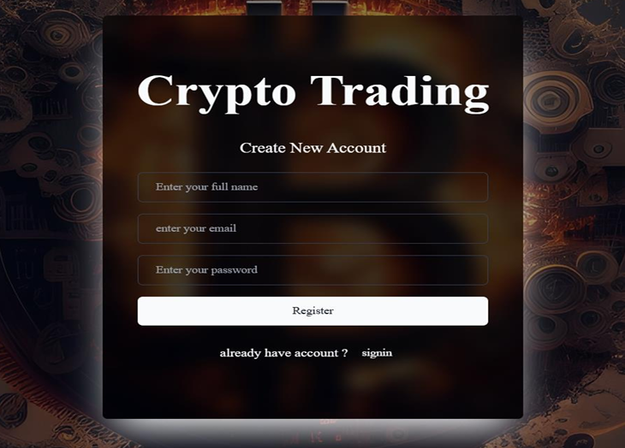
Modules
Module 1: User Registration
Users sign up by providing their name, email, and password.
Information is securely stored in the database.
The registration process ensures only authorized users can access the platform.
Users can reset their password through a secure email link if they forget it.
The platform checks for duplicate accounts using email to prevent multiple registrations.

Slide 9
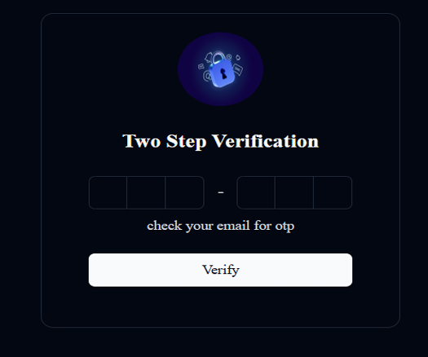
Module-1
Two Factor Authentication
After entering username and password, users receive a one-time code (OTP) via email.
The OTP must be entered on the platform to complete the login process.
Adds an extra layer of security, ensuring unauthorized users cannot access accounts even with a password.
The OTP expires after a set time to prevent misuse.

Slide 10
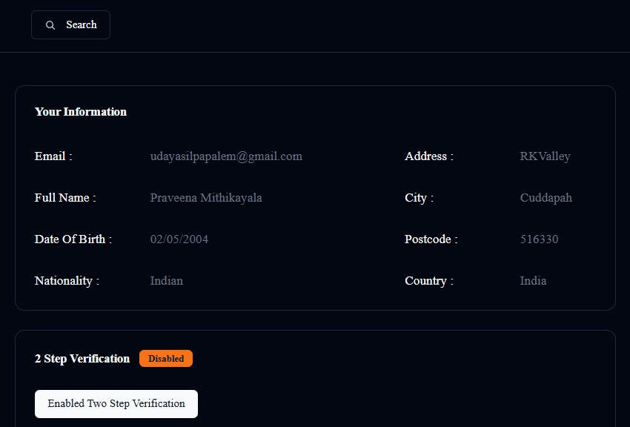
Module-1
User Profile
Each user has a detailed profile containing personal information such as: Full Name, Email, Date of Birth, Nationality, Address, City, Postcode, and Country.
Users can view and update their profile details securely.
The profile ensures personalized user experience and identity verification.
All data is securely stored and handled in compliance with privacy standards.

Slide 11
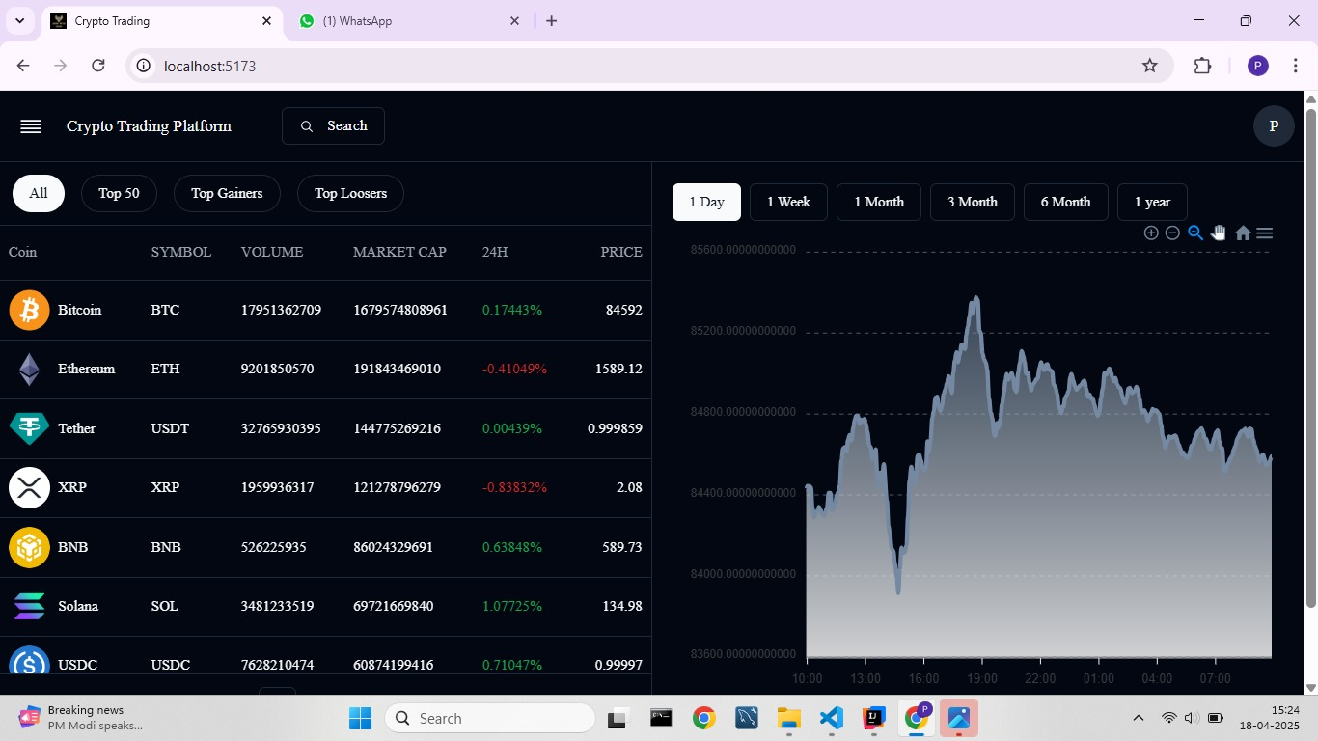
Module-2
Data Visualization
The platform displays real-time data for each cryptocurrency (e.g., Bitcoin, Ethereum, Tether) using interactive area charts.
Charts represent key metrics like price trends, volume, and market fluctuations over time.
Users can visually compare performance and analyze patterns for better trading decisions.
Charts update dynamically, ensuring users always see the latest market movements.
Intuitive design allows users to hover for exact values and time-based insights.

Slide 12
Module-2
Home Page
The homepage displays real-time data for the top cryptocurrencies including Bitcoin, Ethereum, Tether, and more.
Key details shown include name, symbol, current price, market cap, 24h volume, and price change %.
Data is presented in a structured layout with cards or tables for quick readability.
Users can search, filter, and sort cryptocurrencies based on various metrics.
The homepage serves as a dashboard for quick insights and easy navigation to trading and analysis features.

Slide 13
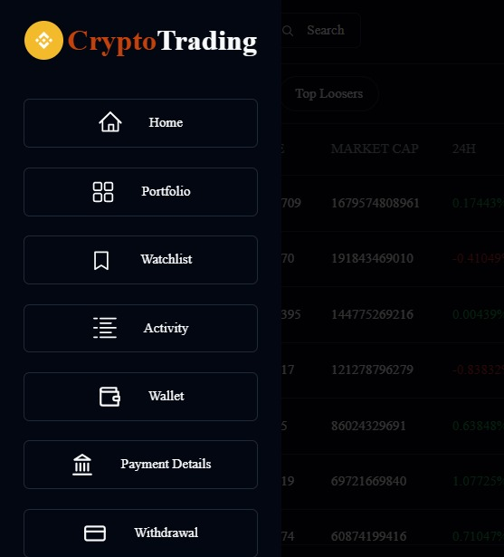
Module-2
Sidebar & Navigation
A fixed sidebar allows smooth navigation across key sections of the platform.
Sidebar includes: Home, Portfolio, Watchlist, Activity, Wallet, Payment Details, and Withdrawal.
Each section icon is clearly labeled for intuitive access and user-friendly interaction.
The layout ensures easy switching between features without losing context.
Designed with responsiveness for seamless use on both desktop and mobile devices.

Slide 14
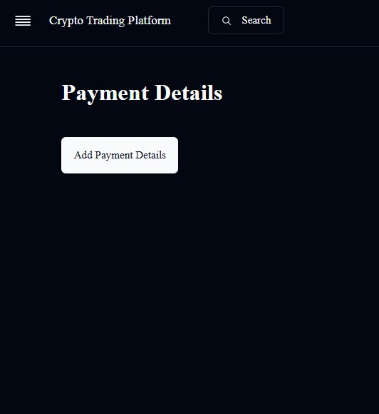
Module-3
Payment Details
The platform supports secure payment processing for buying and trading cryptocurrencies.
Integrated with Razorpay to handle deposits and payments.
Users can view their transaction history, including dates, amounts, and payment methods.
All payment data is encrypted and processed in compliance with security standards.
Supports multiple payment modes like UPI, credit/debit cards, and net banking.

Slide 15
Conclusion
The cryptocurrency trading platform successfully provides a secure and user-friendly environment for trading digital currencies.
Key features like real-time market data, seamless buying and selling, and an intuitive interface enable effective market interaction.
Security is reinforced with 2FA, JWT session management, and chatbot support for real-time assistance.
Integration of CoinGecko API ensures reliable data and secure trade execution.
The platform demonstrates the potential of modern web technologies to create a comprehensive, secure trading solution.

Slide 16
Future Enhancements
Real-time price alerts and automated trading features to personalize buying/selling based on market conditions.
AI-driven chatbot with NLP for handling more complex queries and offering personalized assistance.
Implementation of multi-signature authentication and advanced encryption for enhanced security.
Performance improvements via caching mechanisms and load balancing to ensure reliability during high traffic.
Expansion to support more cryptocurrencies, integrate with additional exchanges, and enable features like staking and margin trading.
These enhancements will help scale the platform and ensure its competitiveness in the growing cryptocurrency market.

Slide 17
References
CoinGecko API Documentation: https://www.coingecko.com/en/api
Spring Boot Documentation: https://spring.io/projects/spring-boot
Spring Security Documentation: https://spring.io/projects/spring-security
Chart.js Documentation: https://www.chartjs.org/docs/latest/
React.js Documentation: https://reactjs.org/docs/getting-started.html
MySQL Documentation: https://dev.mysql.com/doc/
Lombok Documentation: https://projectlombok.org/
OpenAI Chatbot (GPT) Model Overview: https://openai.com/chatgpt
Cryptocurrency Security Best Practices: https://bitcoinmagazine.com/guides/security

Slide 18
THANK YOU

